Slide 1
Predicting Cancer Stage Using Machine Learning Presented by: Hardik Bhatt Date: 1st May 2025

Slide 2
Motivation
Cancer is a leading cause of death globally.
Early-stage detection is vital but often costly and slow.
Goal: Predict a patient’s cancer stage using basic features (age, lifestyle, environment).

Slide 3
Dataset Overview
Source: global_cancer_patients_2015_2024.csv
Rows: 50,000 patients
Features:
Demographics (Age, Gender, Country)
Lifestyle (Smoking, Alcohol, Obesity)
Environment (Air Pollution)
Genetic Risk
Target: Cancer_Stage (Stage 0 to Stage IV)

Slide 4
Why This Question Matters
Diagnostic delays can lead to higher mortality.
Predictive models can triage, prioritize, and educate patients early.
Clinically interpretable features like age and obesity are routinely collected.

Slide 5
Methodology
Preprocessing:
Label encoding for categories
Standard scaling for numeric feature
Exploratory Data Analysis
Train/Test Split: 80/20
Models Used:
Logistic Regression (Baseline)
XGBoost (Proposed)

Slide 6
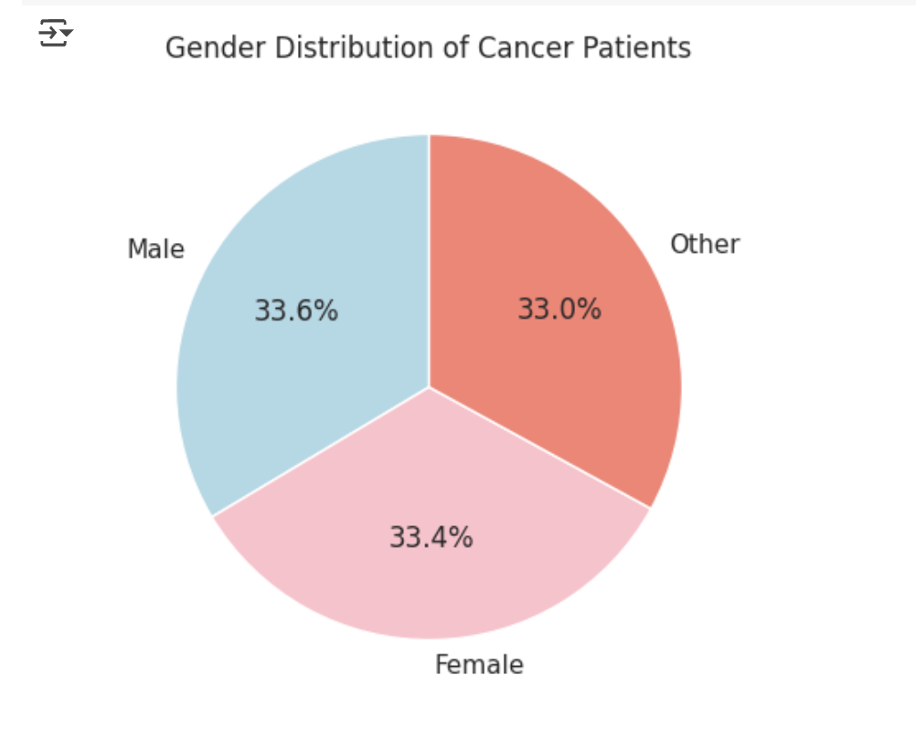

Slide 7
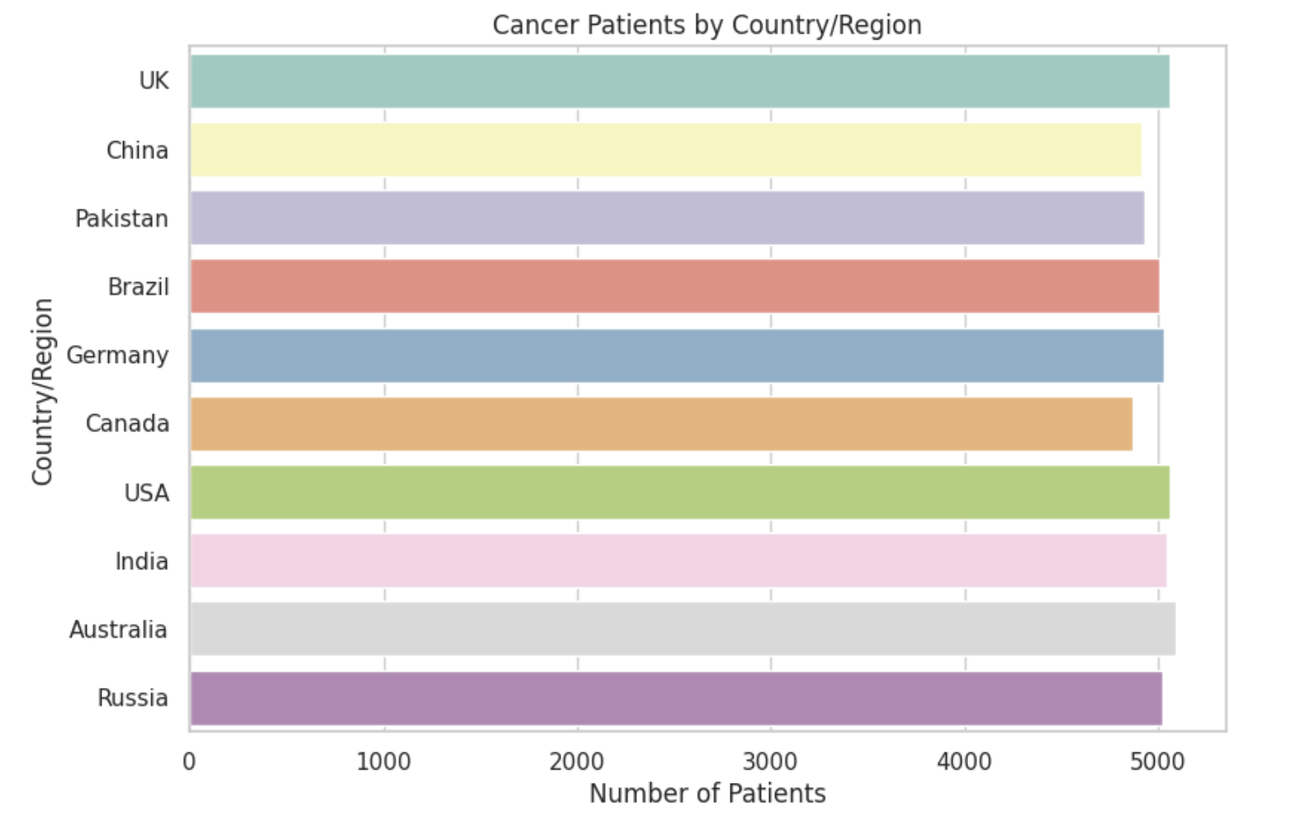

Slide 8
Evaluation Metrics
Accuracy: Overall correctness
F1 Score: Balance between precision & recall
Confusion Matrix: Breakdown of prediction errors

Slide 9
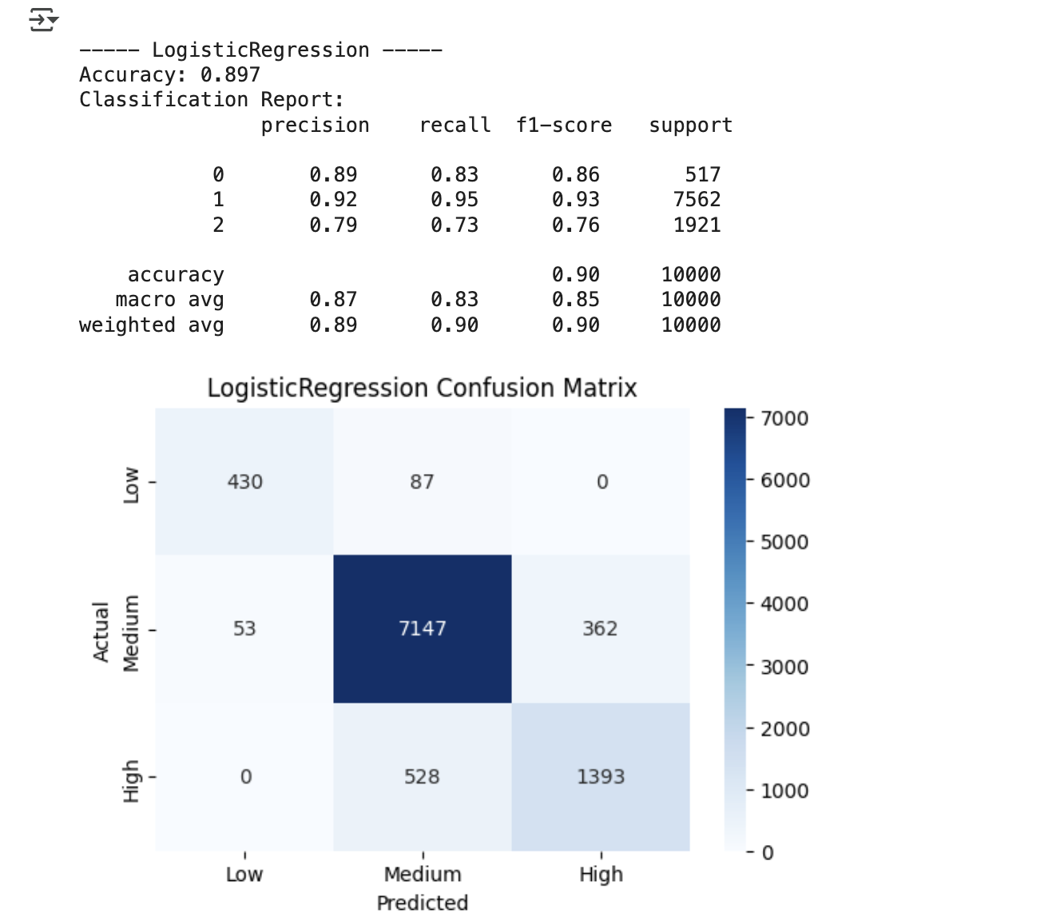
LOGISTIC REGRESSION
(BASELINE)

Slide 10
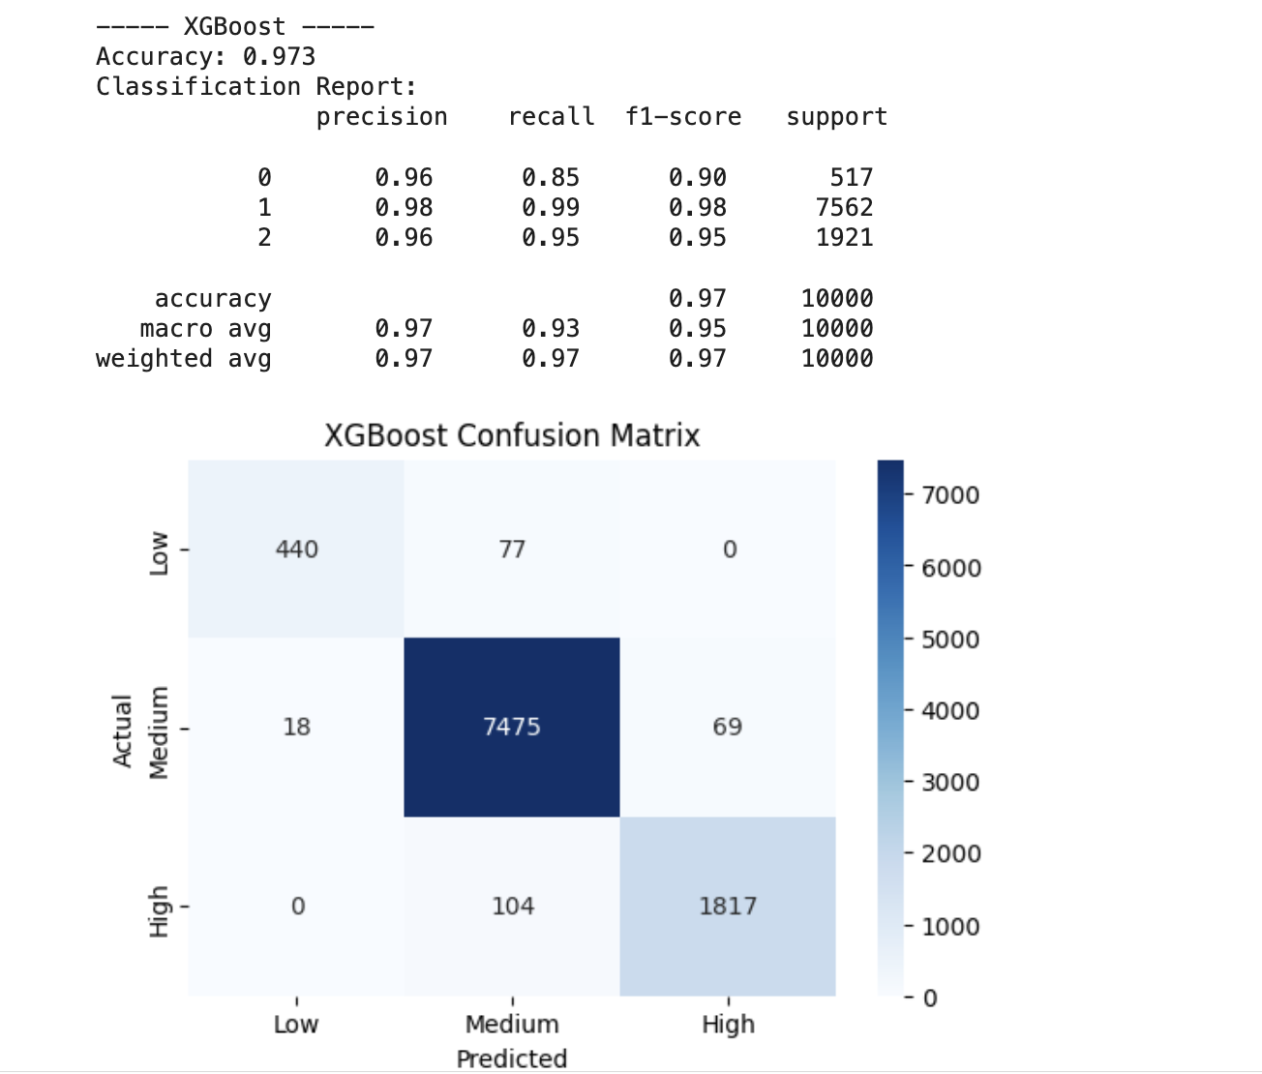
XGBOOST
(PROPOSED)

Slide 11
Real-World Impact
Speeds up triage in rural clinics
Reduces diagnostic delays
Cost-effective preliminary screening
Scalable to national cancer registries

Slide 12
Limitations & Future Work
May miss rare cancer types
Depends on quality of patient data
Next: Add time series, treatment outcome prediction, survival models

Slide 13
To make the model user-friendly, we can deploy it using:
Streamlit (for a web UI)
Package and Share
Share:
model.pkl
predict.py or app.py
requirements.txt (dependencies)
README.md (instructions)

Slide 14
Q&A
“Thank you! I’m happy to take your questions.”

